Slide 1
Welcome
New Employees
Thank You
for joining the
Fountainbleau Lodge

Slide 2
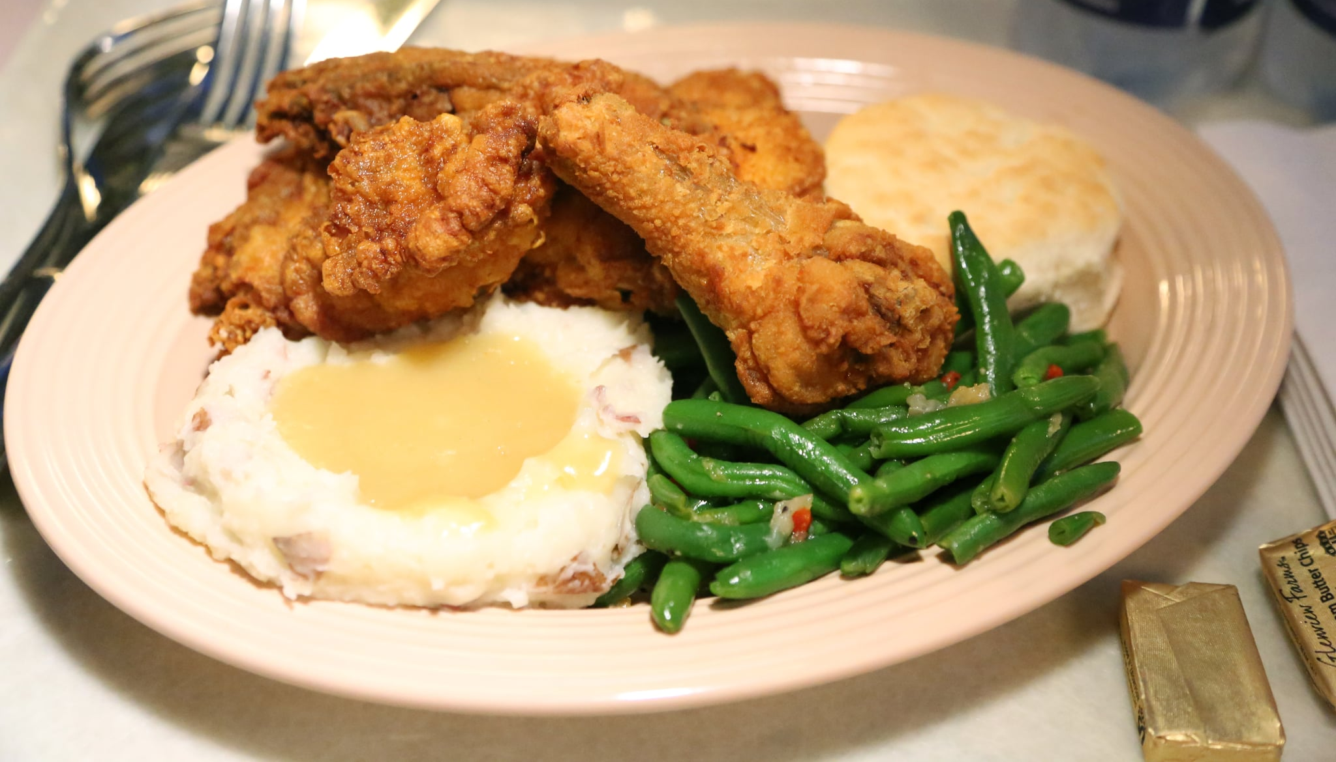
The Mission of Fountainbleau Lodge
Is to enable the RESIDENTS to achieve their highest potential of independent living before and after the onset of illness and/or the aging process.
Safe
Comfortable
Pleasant Environment
Individual Goals
Spirituality
Social Needs
Compassionate Care

Slide 3
First Things 1st!
Parking-Staff will properly park in the front parking lot in non-reserved spaces.
All staff should enter the building through the front entrance.
Staff will enter building wearing a mask & immediately proceed to the COVID screening area to complete that process.
MASK
SANITIZE
SIGN IN DATE/TIME
TEMPERATURE
QUESTIONNAIRE

Slide 4
Timeclock
Clock in no more than 6 minutes before your scheduled shift begins.
The time-keeping system rounds to the quarter hour!
The clock automatically deducts your 30-minute lunch break.
During a power outage, or if you forget to clock in or out-complete the TIME CLOCK EXCEPTION REPORT, so your time can be manually added to your timesheet.
We clock in & clock out, so we can get paid-personal accountability ☺

Slide 5
Personal Use of Cell Phones In Patient Care Areas While On Duty Is Prohibited HIPAA Violation Video - YouTube
Pros & Cons of Smartphones in a Healthcare Workplace
Pros:
Streamlined Communication
Access to reference material
Enhance nursing practice
Cons:
Divided attention
Ignoring of protocol
Security concerns
Photographs and videos violate privacy regulations
Healthcare HIPAA Violations
Notes:
HIPAA Violation Video – YouTube

Slide 6
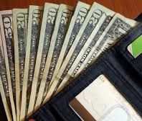
Pay Periods & Pay Dates
1st Through the 15th
Pay Day = 21st
16th Through the End of Month
Pay Day = 7th
Semi Monthly Pay Period=
Twice Per Month
Overtime= Sunday to Saturday
Over 40 Hours

Slide 7
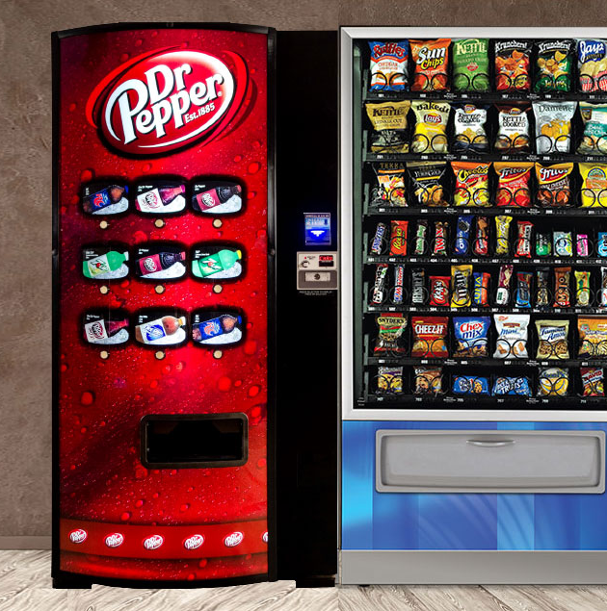
Lunches, Breaks, Smoking
30 Minute Unpaid Lunch Break-Full Time Employees
15 Minute Paid Break After Every Four Hours Worked.
Supervisor/Charge Nurse Will Assign Breaks & Lunches.
Smoking-Only In The Approved Area and Only During Assigned Break Times.
NO SMOKING DURING RESIDENT MEAL-TIMES!
Smoking Area Must Be Kept Neat, Free From Litter and Butts.

Slide 8
DRESS CODE
Appropriate Department Uniform
Name Badge
Non-Skid Shoes
Hair Secured
Black Ink Pen
Gait Belt (C.N.A. & N.A.)
Casual Day on Friday –$1 Donation
Casual Day on Payday = FREE
Design: Scrubs are made to allow movement and flexibility, allowing staff a wide range of motion to perform job duties.
Identification: Different colors and uniforms identify charge nurses, nurse’s assistants, housekeepers, and dietary staff.
Protection: dressing in uniform keeps staff members safe by providing protection from bodily fluids, chemicals and other substances

Slide 9
What is a JOB DESCRIPTION?
The employer communicates expectations of the job to the employee through a job description!!
General overview
Job duties
Purpose of the job
Goals and objectives
Scope of the work
Working conditions
Qualifications or requirements
Immediate supervisor
Supervisory responsibilities
Special circumstances

Slide 10
Teamwork Skills Teamwork Tips for Nursing - YouTube
Notes:
Teamwork Tips for Nursing – YouTube

Slide 11
General Safety Guidelines!
Drug & Alcohol-Free On The Job
Report Maintenance Hazards & Repairs
Report Incidents & Injuries
Wear Protective Gloves
Handwash
Wear Eye Protection
Wear Face Mask
Wear Personal Protective Equipment
Understand Disaster Procedures
Replace Sharps Containers When 2/3 Full
Keep Fire Exits Clear
Wet Floor Signs
No Extension Cords
Report Security Concerns
Follow All Policy and Procedures
Attend Ongoing In-Service Training

Slide 12
Most Common: Hepatitis B Hepatitis C HIV UNIVERSAL PRECAUTIONS
Bloodborne Pathogens Protecting Patients and Health Workers from Bloodborne Disease – YouTube

Slide 13
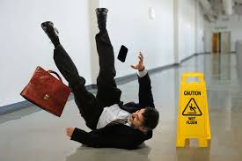
FRICTION
MOMENTUM
GRAVITY
Slips, Trips & Falls
PREVENTING SLIPS, TRIPS, AND FALLS | Safety video & Toolbox Talk - YouTube
Notes:
PREVENTING SLIPS, TRIPS, AND FALLS | Safety video & Toolbox Talk - YouTube

Slide 14
Report accidents and injuries before the end of your shift.
Community Manor is responsible for taking appropriate follow-up action, including directing medical attention, completing an investigation report and recommending or implementing appropriate corrective actions.
Community Manor may direct medical treatment as allowed by the Missouri workers compensation statute.
Any request for medical treatment should be made to your Supervisor at Community Manor.
If you choose to seek care on your own without authorization it may be at your own expense.
If you receive medical care and after an investigation your condition is deemed not work-related according to the workers compensation statutes, you or your insurance company will be liable for the medical charges.

Slide 15
Proper Handwashing Steps- 40-60 SECONDS! Hand-washing Steps Using the WHO Technique - YouTube
Notes:
Hand-washing Steps Using the WHO Technique - YouTube

Slide 16
Proper Hand Rubbing Steps 20-30 SECONDS
Hand Rubbing Steps Using the WHO Technique - YouTube
Notes:
Hand Rubbing Steps Using the WHO Technique – YouTube

Slide 17
5 moments for hand hygiene
The 5 Moments of Hand Hygiene - YouTube
Notes:
The 5 Moments of Hand Hygiene - YouTube

Slide 18
Properly DON P.P.E. Demonstration of Donning (Putting On) Personal Protective Equipment (PPE) - YouTube
PERSONAL
PROTECTIVE EQUIPMENT
ISOLATION GOWN
N 95 RESPIRATOR
FACE MASK
FACE SHIELD
GOGGLES
GLOVES

Slide 19
DOFF PPE Demonstration of Doffing (Taking Off) Personal Protective Equipment (PPE) - YouTube
Notes:
Demonstration of Doffing (Taking Off) Personal Protective Equipment (PPE) - YouTube

Slide 20
REGULATED MEDICAL WASTE (BIOHAZARDOUS WASTE)
What Is Regulated Medical Waste (RMW)? - YouTube
Notes:
What Is Regulated Medical Waste (RMW)? - YouTube

Slide 21
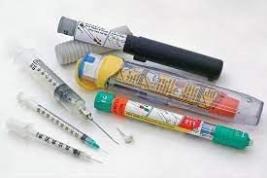
How To Dispose of Sharps!
How To Properly Dispose Of Sharps And Medical Waste - YouTube
Notes:
How To Properly Dispose Of Sharps And Medical Waste - YouTube

Slide 22
How to use an Emergency EYE WASH STATION
Emergency Eyewash - Safety Training Video - Protect Your Vision After Accidents - YouTube
Notes:
Emergency Eyewash - Safety Training Video - Protect Your Vision After Accidents - YouTube

Slide 23
Lock-Out Tag-Out Procedure
Lockout Tagout | An introduction to the control of hazardous energy. - YouTube
Notes:
Lockout Tagout | An introduction to the control of hazardous energy. - YouTube

Slide 24
PASS Fire Extinguisher Operation
How to Use a Fire Extinguisher Using the PASS Method - YouTube
Notes:
How to Use a Fire Extinguisher Using the PASS Method – YouTube
How to Use a Fire Extinguisher Using the PASS Method - YouTube

Slide 25
Safety Data Sheets
5 Important Things To Know About A Safety Data Sheet - YouTube
Notes:
5 Important Things To Know About A Safety Data Sheet - YouTube

Slide 26
Seasonal Influenza Vaccination
The flu vaccine: explained - YouTube
Notes:
The flu vaccine: explained - YouTube

Slide 27
Are You Vaccinated?

Slide 28
HIPAA What You Need To Know!
https://www.youtube.com/watch?v=WXjcvw9QCzw
Notes:
https://www.youtube.com/watch?v=WXjcvw9QCzw
\

Slide 29
Social Media HIPAA Violations
Six Real-World Examples of Social Media HIPAA Violations - YouTube
Notes:
Six Real-World Examples of Social Media HIPAA Violations - YouTube

Slide 30
Resident Rights
https://www.youtube.com/watch?v=gPhy5DdQnig
Notes:
https://www.youtube.com/watch?v=gPhy5DdQnig

Slide 31
Abuse, Neglect, Exploitation & Misappropriation
https://www.youtube.com/watch?v=gUy0QbMaNG8
Notes:
https://www.youtube.com/watch?v=gUy0QbMaNG8

Slide 32
Workplace Violence
Workplace Violence Training for Healthcare Workers - YouTube
Notes:
Workplace Violence Training for Healthcare Workers - YouTube

Slide 33
Diversity & Inclusion
Equality Diversity & Inclusion in 2021 - WHAT'S IT ALL ABOUT? - YouTube
Notes:
Equality Diversity & Inclusion in 2021 - WHAT'S IT ALL ABOUT? - YouTube

Slide 34
Battery Operated Hoyer Lifts
https://www.youtube.com/watch?v=rXJyfWi2zPk
Notes:
https://www.youtube.com/watch?v=rXJyfWi2zPk

Slide 35
Gait Belt Transfer Introduction
https://www.youtube.com/watch?v=r0azePlFx5c
Notes:
https://www.youtube.com/watch?v=r0azePlFx5c

Slide 36
Fall Interventions
https://www.youtube.com/watch?v=xW-jYurjTBo
Notes:
https://www.youtube.com/watch?v=xW-jYurjTBo

Slide 37
Activities Of Daily Living or ADLs
https://www.youtube.com/watch?v=gpaNVD3GteM
Notes:
https://www.youtube.com/watch?v=gpaNVD3GteM

Slide 38
What Not To Do….
https://www.youtube.com/watch?v=hrKA6tzDnOQ
Notes:
https://www.youtube.com/watch?v=hrKA6tzDnOQ

Slide 39
How To Talk To Someone With Dementia
How to Talk to Someone With Dementia - YouTube
Notes:
How to Talk to Someone With Dementia - YouTube

Slide 40
Dementia Communication
HOW TO COMMUNICATE THERAPEUTICALLY WITH A PATIENT WHO HAS DEMENTIA - YouTube
Notes:
HOW TO COMMUNICATE THERAPEUTICALLY WITH A PATIENT WHO HAS DEMENTIA - YouTube

Slide 41
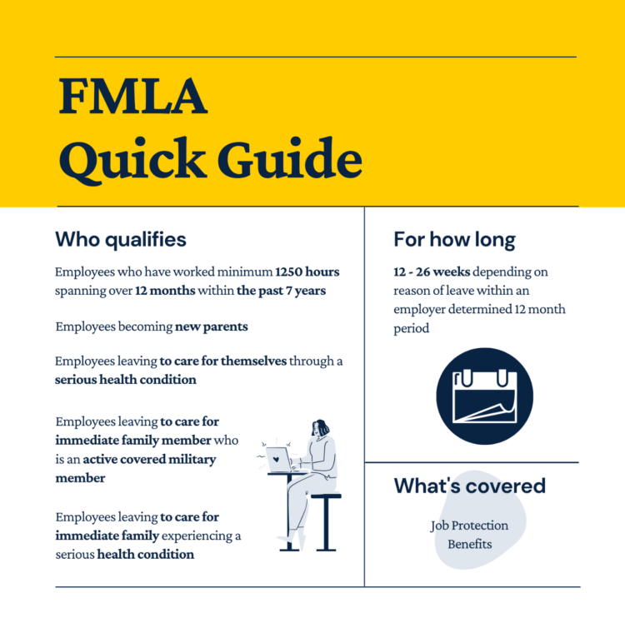

Slide 42
All Staff Are Required To Attend Mandatory In-Service Education
Policies/Procedures
Resident Care
Resident Satisfaction
Resident Rights
Abuse & Neglect Protocol
HIPAA Privacy
Disaster Preparedness
OSHA & Safety Subject Matter
Pandemic Related
C.N.A. Annual Training
RN/LPN Procedures
One on One Training

Slide 43
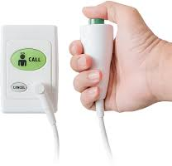
Answering Call Lights
Call Light On
Passerby Responds
Addresses Needs
Needs Met?
YES!!
Stop Here
If NO…
Delegates to Appropriate Staff
Addresses Needs
Needs Met!

Slide 44
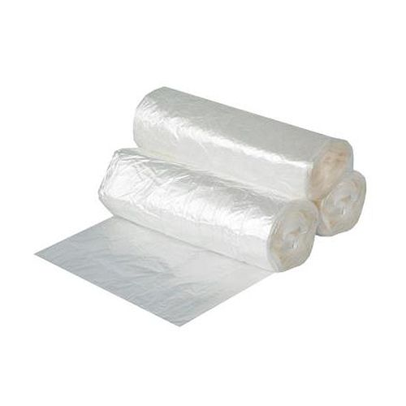
BAG THOSE SOILED LINENS
& USED BRIEFS !!
Minimize the spread of bacteria during transport.
To prevent spreading bacteria across additional surfaces or through the air, you need to minimize handling the laundry and avoid agitation.
Never rinse or sort soiled laundry at the location where it was used, such as the patient’s room or shower room.
Place the laundry into bags or other appropriate containment in the original location and tie the bags securely.
Bag and tie used briefs separately, DO NOT PLACE IN TRASH CANS!
Avoid squeezing or holding the bags near the body during transport to avoid puncturing.
Transport soiled linens and briefs to their assigned barrels.

Slide 45
Missouri VESSA
Missouri’s new Victims Safety and Security Act (VESSA)

Slide 46
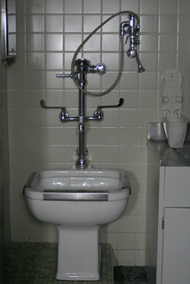
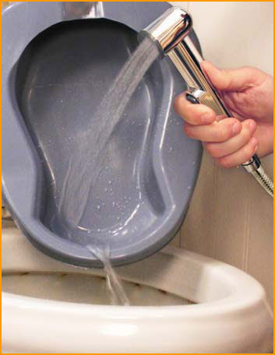
Soiled Utility Room

Slide 47
Staff Members are Eligible for
Health Benefit Enrollment
after 90 Day Probationary Period
Customizable Insurance Options
Option 1 Blue Access $1500 Deductible & 20% Coinsurance
Option 2 Blue Preferred Select $3000 Deductible & 0% Coinsurance
Option 3 Blue Preferred Select $5000 Deductible & 20% Coinsurance
Guardian: Dental, Vision, Life, Long Term Disability

Slide 48
Staff Members are Eligible for
401K
after 1 Year of Employment

Slide 49
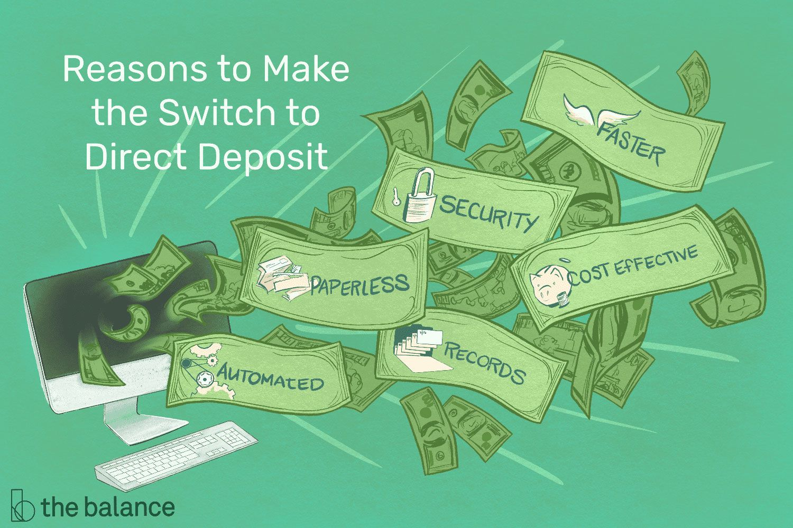
Staff Members are Eligible for
PAYROLL DIRECT DEPOSIT after 90-day Probationary Period

Slide 50
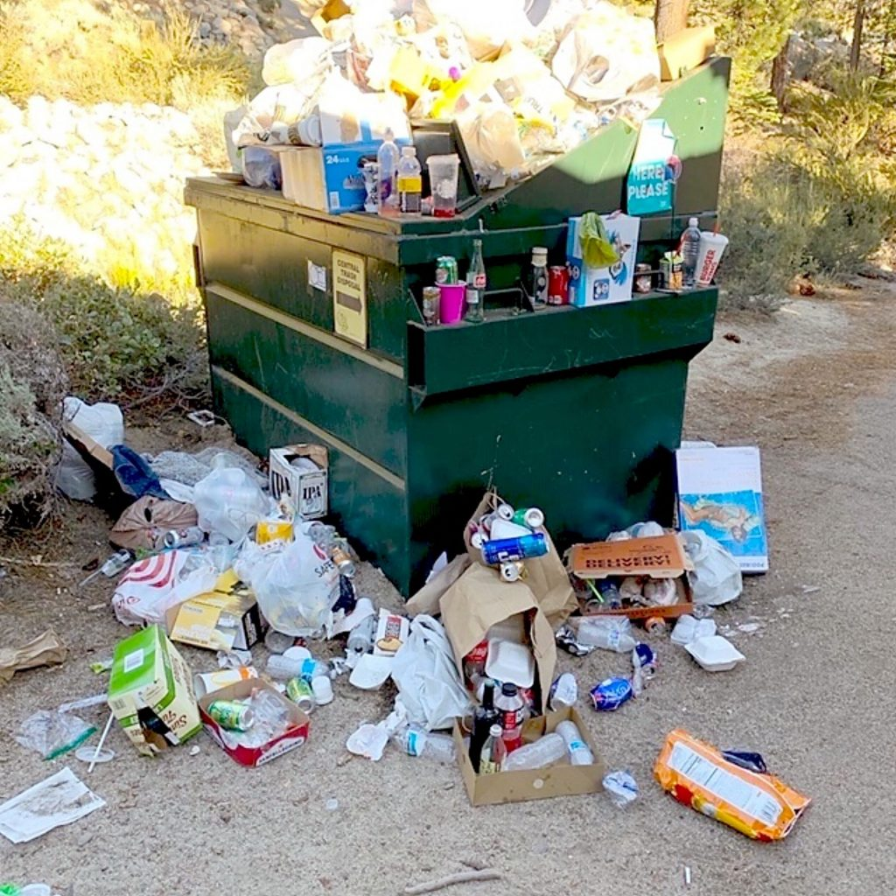

Slide 52
Disaster/Emergency Preparedness Manual
Emergencies that nursing home officials prepare for include:
Compromised or collapsed buildings.
Cyber attacks.
Disrupted food or water supply.
Earthquakes.
Fires.
Snowstorms.
Hurricanes.
Pandemics.
Power outages.

Slide 53
Chain of Command
Management Entity
Administrator- Dept Managers
DON- Nursing Department
Dept Managers Dept Staff
ALL Staff Must Report To and Follow Direction of His or Her Immediate Supervisor!!!
If you have a question about who you report to, please ask.

Slide 54
Resident Environment
Homelike
Comfortable
Clean, Sanitary
Orderly, Organized
Odor Free
Bed Clean & Neatly Made
Clutter=Fall Hazard
Decorated, Personalized
Personal Items Protected
Grooming Supplies Put Away
Adequate Lighting
Comfortable Temperatures
Controlled Sound Level
Call Light Within Reach
Ice Water Passed
Drinks, Snacks Within Reach
Remote, Telephone, Trash Can
Books, Puzzles, Activity Materials
TV, Radio, Electronics
Oxygen & Nebulizer Tubing
(dated, bagged, off floor/bed)
Oxygen Signage
Clean Linens Not Stacked
No Unapproved Electrical Appliances
No Extension Cords
No Weapons or other Contraban

